Slide 1

TiranaGoes Green
Plant a tree & take your bike

Slide 2
The problem
The small number of green areas in the city leads to several environmental, social, and health-related challenges
Increased urban heat
Poor air quality
Reduced biodiversity

Slide 3
01
Carbon Footprint Reporting

Slide 4
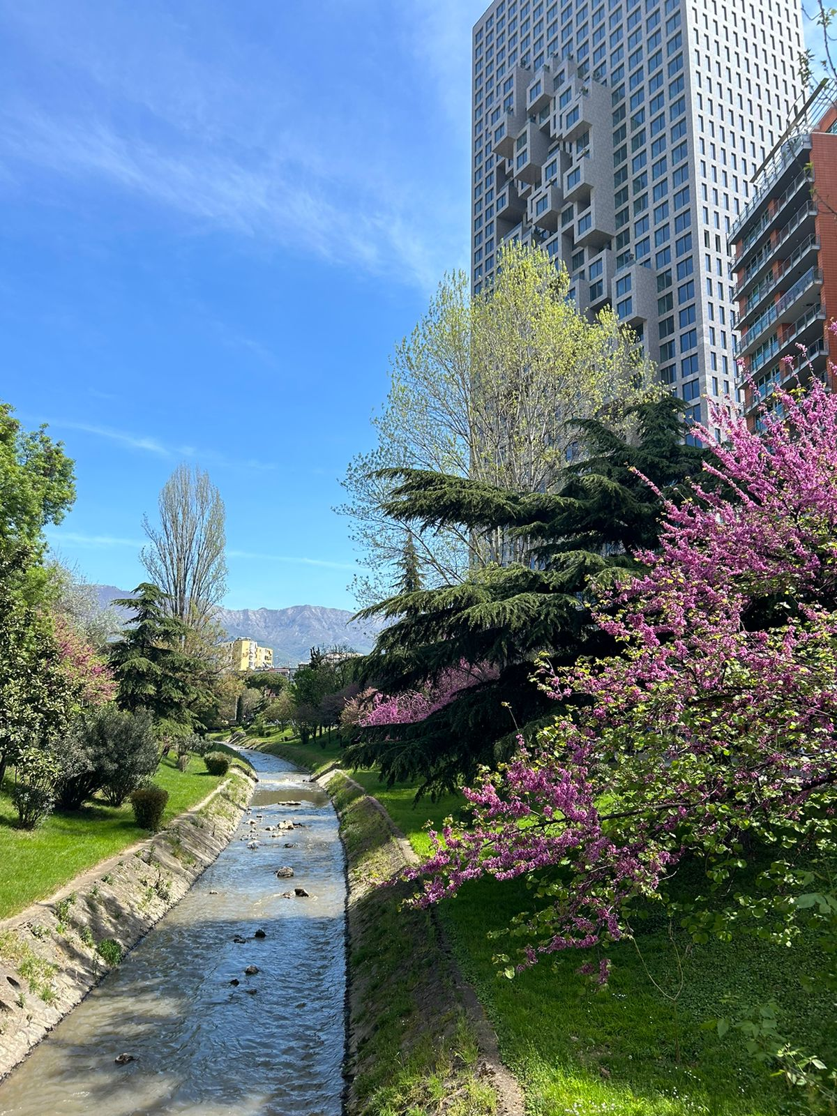
By prompting users to donate money which will go to tree planting, the platform actively supports on reducing carbon emissions.
Trees absorb CO₂, while cycling eliminates vehicle emissions.

Slide 5
02
Sustainable Living

Slide 6
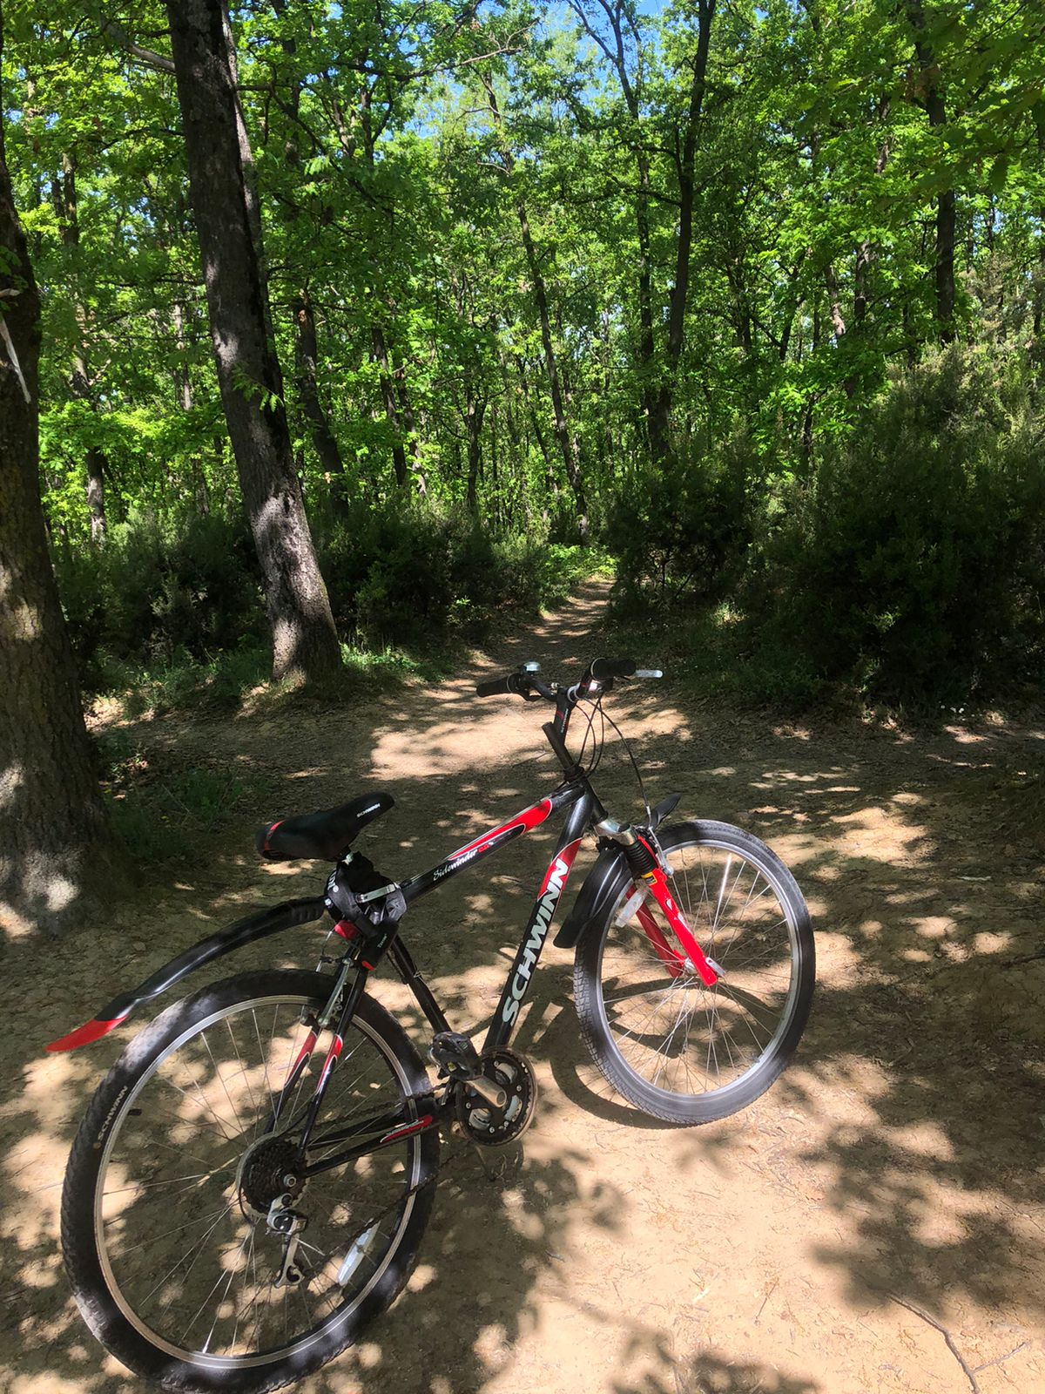
How do we tackle it?
By the usage of bicycles, the platform fosters a culture of sustainability by encouraging eco-friendly transportation and supporting reforestation.
It provides actionable steps—such as donating to plant trees or choosing bicycles—empowering users to adopt greener habits that contribute to long-term environmental sustainability.

Slide 7
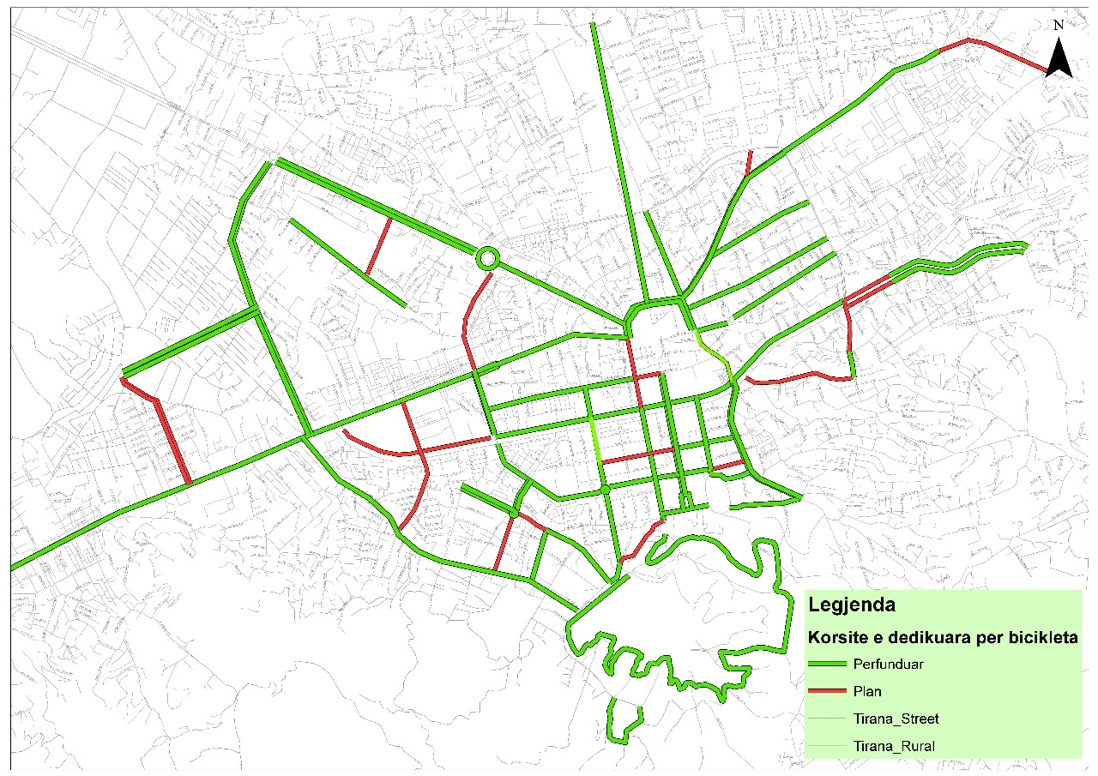

Slide 8
03
Climate Change Mitigation

Slide 9
Captuing CO₂
Cutting greenhouse gas emissions
Tree planting directly addresses climate change by capturing atmospheric CO₂ and restoring ecosystems.
Promoting cycling reduces reliance on fossil fuels, cutting greenhouse gas emissions.

Slide 10
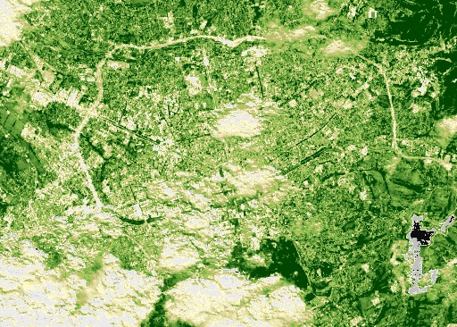
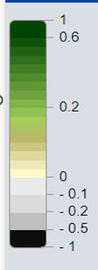

Slide 11
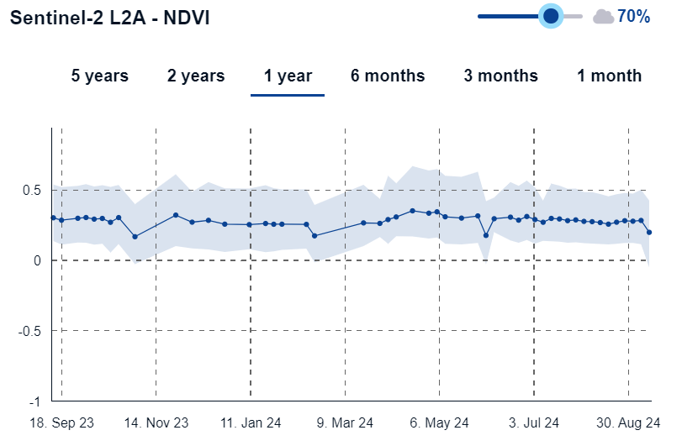
Sentiel-2 L2A NVDI
0.17
02 Nov
0.26
31 Jan
0.30
31 May

Slide 12
Our clients -target
Location
70%
Tirana
30%
Preferences
Age
Not already invloved in biking
6-70
50%
30%
Involved in biking
20%
Nearby areas
Activists

Slide 13
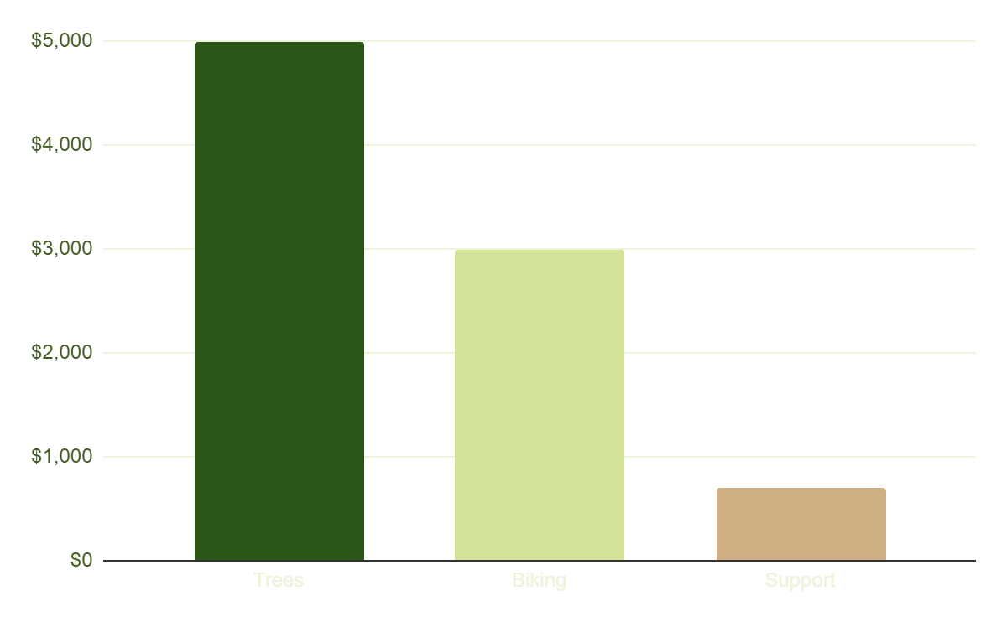
Estimatable yearly profits
Trees
58%
Biking
34%
Government support
8%
Profits from planting trees donations
From biking companies we will promote
Monetary support from the municipality

Slide 14
ALL 870,000
TOTAL TARGET

Slide 15
Work in progress
Add a flag
Get more businesses invloved
Choose the area
Organize campaigns
Adding a tree to the area of the map where you have contributed
Contacts with businesses which are interested to offer bikes to rent
Choose the area where you want to contribute
Invite users to environmental campaigns

Slide 16
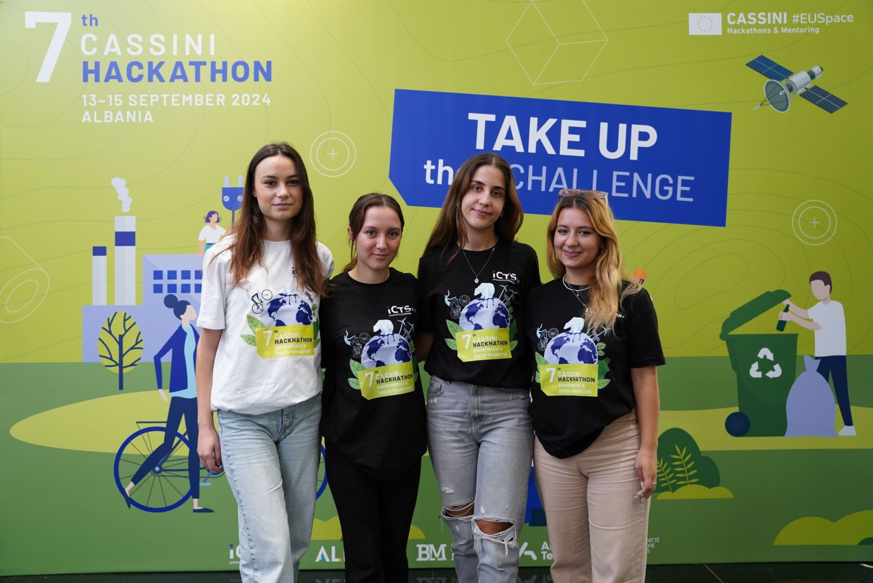
Thank you!
Do you have any questions?

